Slide 1
AI RNN LSTM

Slide 2
source
https://dennybritz.com/posts/wildml/recurrent-neural-networks-tutorial-part-1/
https://www.youtube.com/watch?v=yZv_yRgOvMg

Slide 3
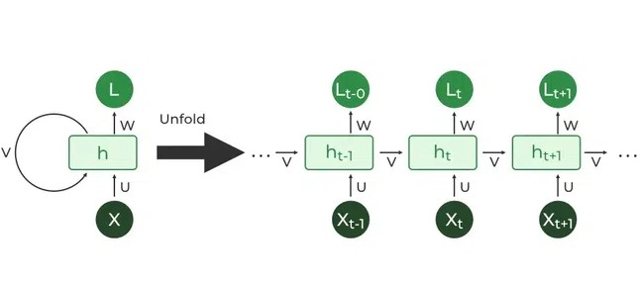
Architecture
RNNs are a type of neural network with hidden states and allow past outputs to be used as inputs. Here’s a breakdown of its key components:
Input Layer: This layer receives the initial element of the sequence data. For example, in a sentence, it might receive the first word as a vector representation.
Hidden Layer: The heart of the RNN, the hidden layer contains a set of interconnected neurons. Each neuron processes the current input along with the information from the previous hidden layer’s state. This “state” captures the network’s memory of past inputs, allowing it to understand the current element in context.
Activation Function: This function introduces non-linearity into the network, enabling it to learn complex patterns. It transforms the combined input from the current input layer and the previous hidden layer state before passing it on.
Output Layer: The output layer generates the network’s prediction based on the processed information. In a language model, it might predict the next word in the sequence.
Recurrent Connection: A key distinction of RNNs is the recurrent connection within the hidden layer. This connection allows the network to pass the hidden state information (the network’s memory) to the next time step. It’s like passing a baton in a relay race, carrying information about previous inputs forward

Slide 4
RNN
RNN incorporates loops that allow information from previous steps to be fed back into the network. This feedback enables RNNs to remember prior inputs making them ideal for tasks where context is important.

Slide 5
RNN: Feed Forward Propagation (TODO from Batch9)

Slide 6
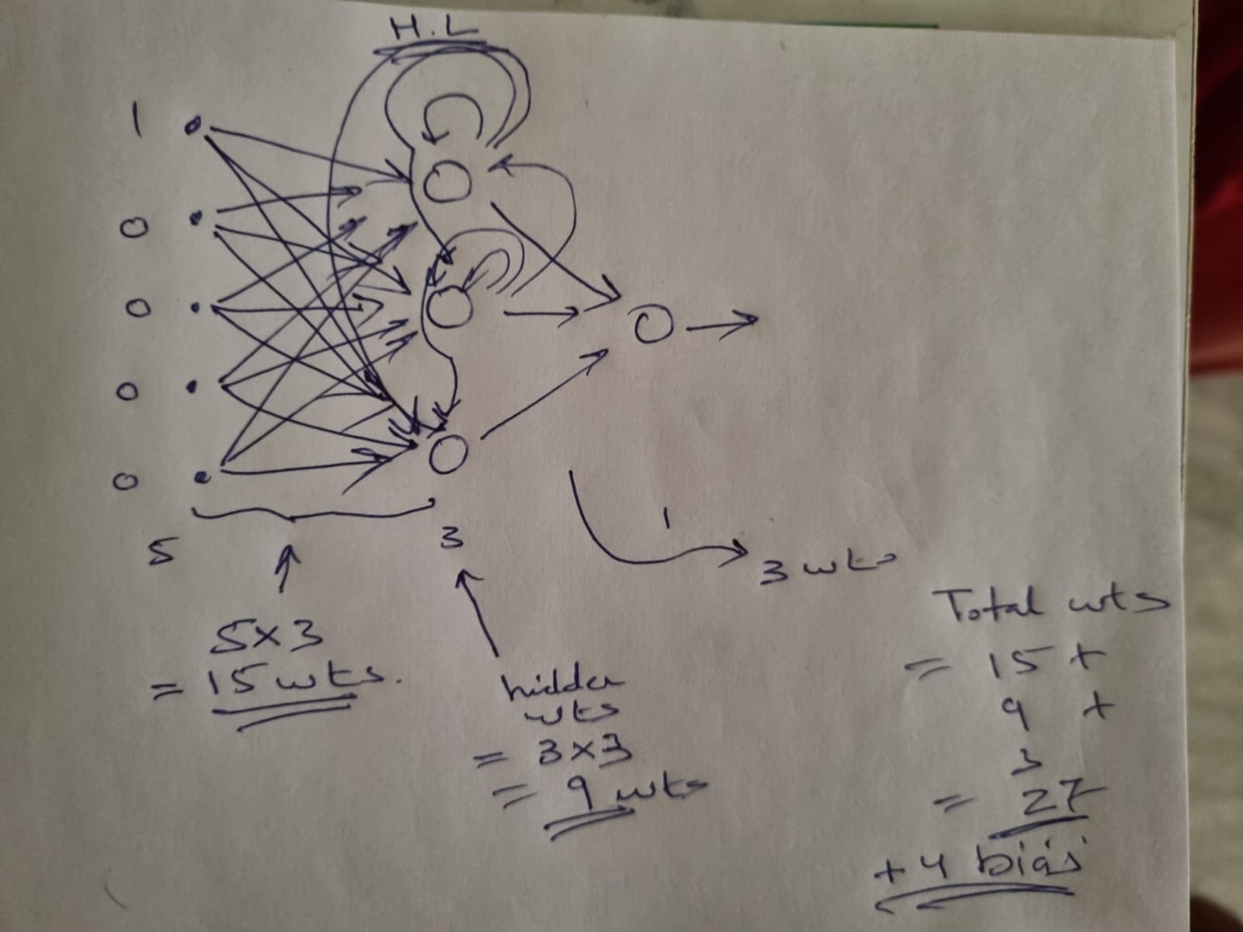
RNN: How many parameters(wts+bias) ? Ans: 27+4=31

Slide 7
RNN: Back propagation Theory(TODO)

Slide 8
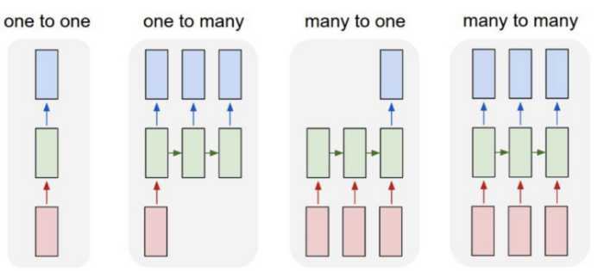
Types of RNN
One-to-one RNN models have one input and one output. One-to-one architecture is used in traditional neural networks and for general machine learning tasks like image classification.
One-to-many RNNs have one input and several outputs. This enables image captioning or music generation capabilities, as it uses a single input (like a keyword) to generate multiple outputs (like a sentence).
Many-to-one model has several inputs and one output. Tasks like sentiment analysis or text classification often use many-to-one architectures. For example, a sequence of inputs (like a sentence) can be classified into one category (like if the sentence is considered a positive/negative sentiment).
Many-to-many models map several inputs to several outputs. Machine translation and name entity recognition are powered by many-to-many RNNs, where multiple words or sentences can be structured into multiple different outputs (like a new language or varied categorizations).

Slide 9
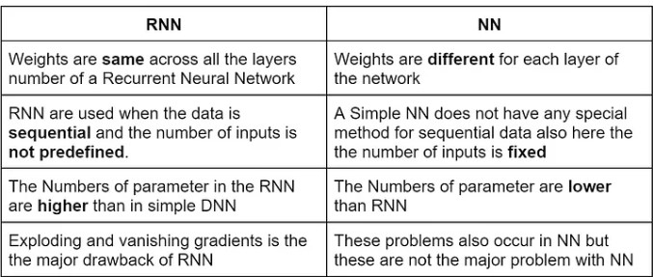
Difference between RNN and simple NN

Slide 10
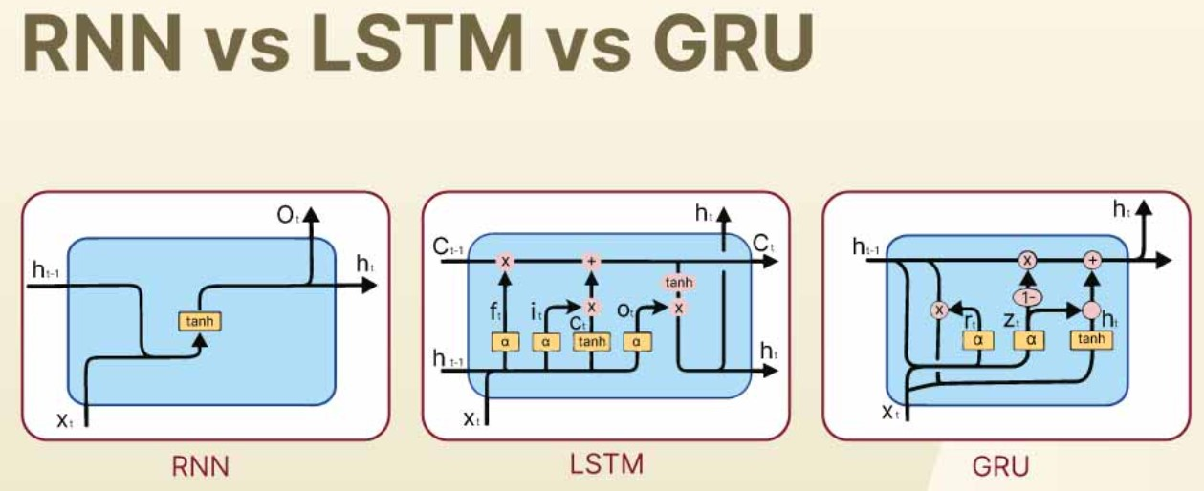

Slide 11
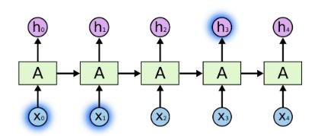
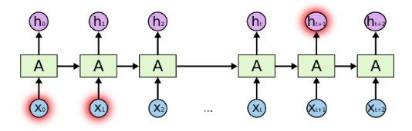
LSTM Architecture(p1):
source https://colah.github.io/posts/2015-08-Understanding-LSTMs/
The Problem of Long-Term Dependencies:
Sometimes, we only need to look at recent information to perform the present task. For example, consider a language model trying to predict the next word based on the previous ones. If we are trying to predict the last word in “the clouds are in the sky,” we don’t need any further context – it’s pretty obvious the next word is going to be sky. In such cases, where the gap between the relevant information and the place that it’s needed is small, RNNs can learn to use the past information.
But there are also cases where we need more context. Consider trying to predict the last word in the text “I grew up in France… I speak fluent French.” Recent information suggests that the next word is probably the name of a language, but if we want to narrow down which language, we need the context of France, from further back. It’s entirely possible for the gap between the relevant information and the point where it is needed to become very large.
Unfortunately, as that gap grows, RNNs become unable to learn to connect the information
In theory, RNNs are absolutely capable of handling such “long-term dependencies.” A human could carefully pick parameters for them to solve toy problems of this form. Sadly, in practice, RNNs don’t seem to be able to learn them. The problem was explored in depth by Hochreiter (1991) [German] and Bengio, et al. (1994), who found some pretty fundamental reasons why it might be difficult.
Thankfully, LSTMs don’t have this problem!

Slide 12
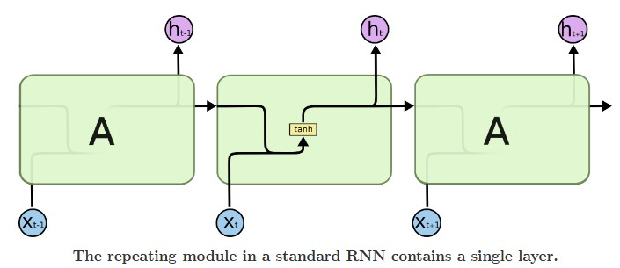
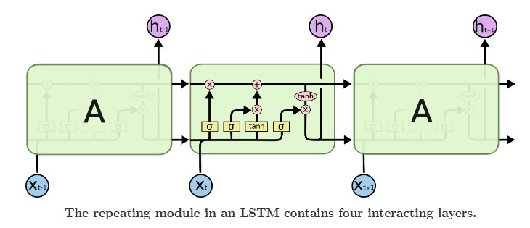

LSTM Architecture(p2):
source https://colah.github.io/posts/2015-08-Understanding-LSTMs/
LSTM Networks
Long Short Term Memory networks – usually just called “LSTMs” – are a special kind of RNN, capable of learning long-term dependencies. They were introduced by Hochreiter & Schmidhuber (1997), and were refined and popularized by many people in following work.¹ They work tremendously well on a large variety of problems, and are now widely used.
LSTMs are explicitly designed to avoid the long-term dependency problem. Remembering information for long periods of time is practically their default behavior, not something they struggle to learn!
All recurrent neural networks have the form of a chain of repeating modules of neural network. In standard RNNs, this repeating module will have a very simple structure, such as a single tanh layer.
LSTMs also have this chain like structure, but the repeating module has a different structure. Instead of having a single neural network layer, there are four, interacting in a very special way.
Don’t worry about the details of what’s going on. We’ll walk through the LSTM diagram step by step later. For now, let’s just try to get comfortable with the notation we’ll be using.
In the above diagram, each line carries an entire vector, from the output of one node to the inputs of others. The pink circles represent pointwise operations, like vector addition, while the yellow boxes are learned neural network layers. Lines merging denote concatenation, while a line forking denote its content being copied and the copies going to different locations.

Slide 13
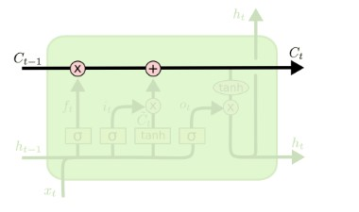
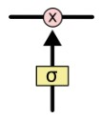
LSTM Architecture(p3):
source https://colah.github.io/posts/2015-08-Understanding-LSTMs/
The Core Idea Behind LSTMs
The key to LSTMs is the cell state, the horizontal line running through the top of the diagram.
The cell state is kind of like a conveyor belt. It runs straight down the entire chain, with only some minor linear interactions. It’s very easy for information to just flow along it unchanged.
The LSTM does have the ability to remove or add information to the cell state, carefully regulated by structures called gates.
Gates are a way to optionally let information through. They are composed out of a sigmoid neural net layer and a pointwise multiplication operation.
The sigmoid layer outputs numbers between zero and one, describing how much of each component should be let through. A value of zero means “let nothing through,” while a value of one means “let everything through!”
An LSTM has three of these gates, to protect and control the cell state.

Slide 14
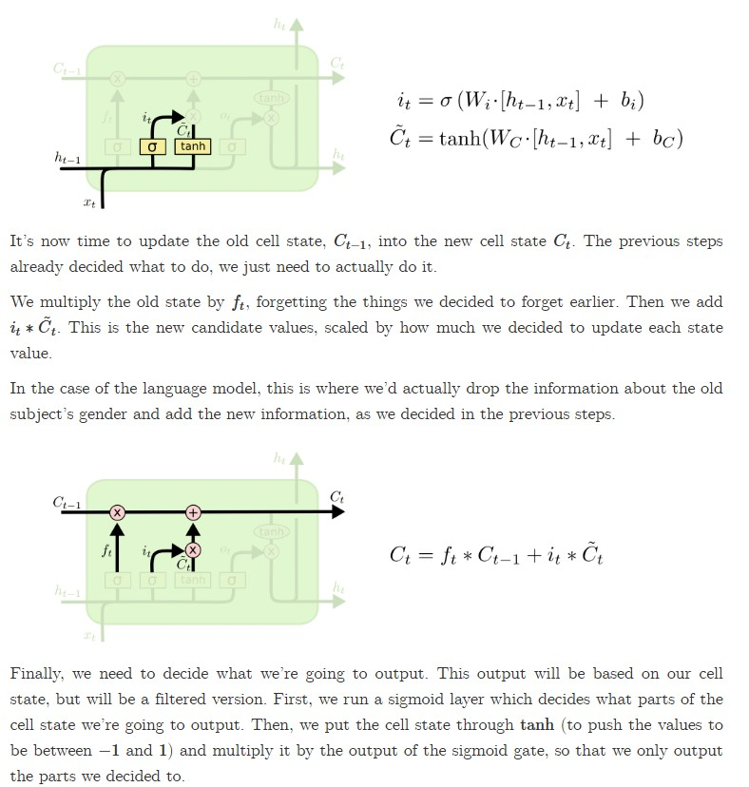
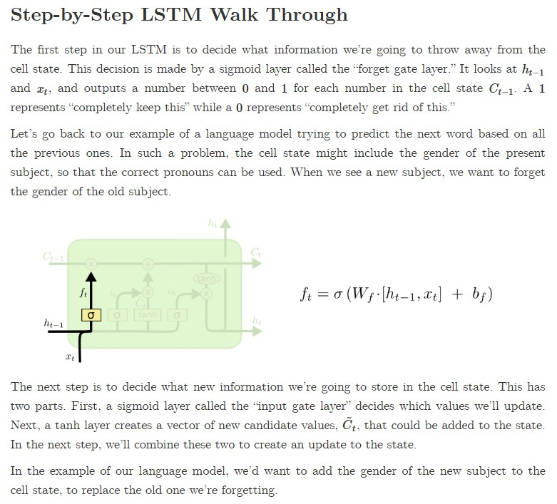
LSTM Architecture(p4):
source https://colah.github.io/posts/2015-08-Understanding-LSTMs/
Continued next page

Slide 15
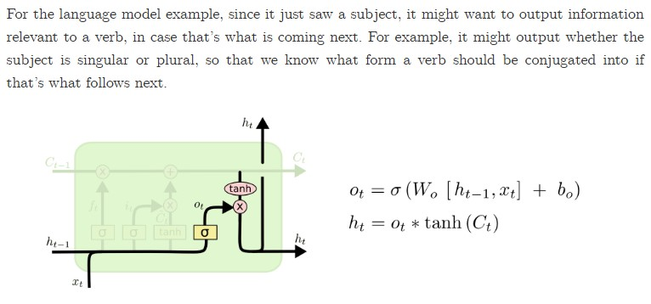
LSTM Architecture(p5):
source https://colah.github.io/posts/2015-08-Understanding-LSTMs/

